Slide 1
Disrupting Big Data with Apache Spark in the Cloud
Ali Ghodsi Co-Founder and CEO
Notes:
I HAVE AN ANNOUNCEMENT TODAY
BUT FIRST, WANT TO TALK ABOUT DATABRICKS

Slide 2


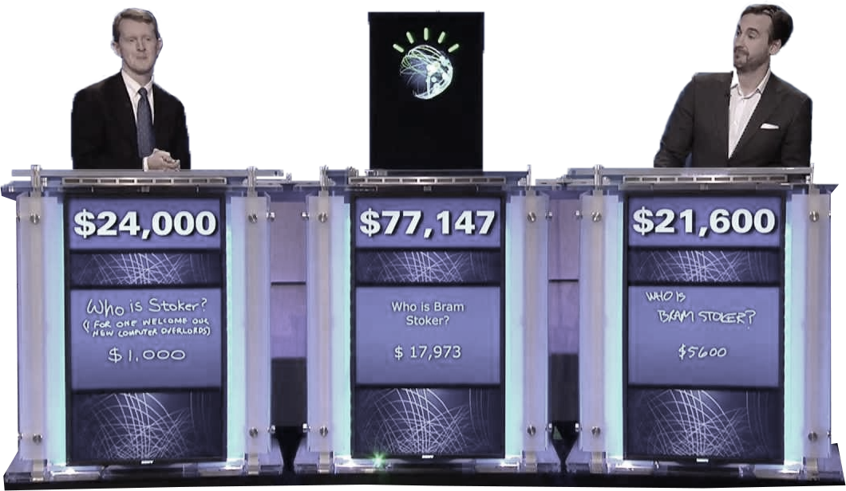
The Dawn of Advanced Analytics
Self-driving cars
SIRI/assistants
Watson
Not just sci-fi, important applications for businesses
Notes:
THIS IS NOT JUST SCI-FI

Slide 3


Analytics Transforming Industries
Predictive analytics
Anomaly Detection
Predict Product Revenue
Customer Assessment
Targeted Advertising
Fraud Detection
Risk Assessment
Equipment Failure
Data-Driven Real-time Analytics Applications

Slide 4
Today’s Data Reality
DATA WAREHOUSES
HADOOP DATA LAKES
DATA HUBS
CLOUD STORAGE
Siloed, Fast-Growing Size, Cost

Slide 5




The Analytics Gap
Real-time Data-Driven Analytics Applications
Pharma
Media
Industrial
DATA WAREHOUSES
HADOOP DATA LAKES
DATA HUBS
CLOUD STORAGE
Siloed, Fast-Growing Size, Cost

Slide 6
Why is there a gap?
Real-time Data-Driven Analytics Applications
Manage Data infrastructure
Create, tune, monitor compute clusters.
Securely access silos of disparate data sources.
Enforce proper data governance.
1
Empower teams to be productive
2
Securely share big data clusters among analysts.
Interactively explore data and prototype ideas.
Debug, troubleshoot, version-control big data applications.
Establish Production- Ready Applications
3
Setup robust data pipelines for ETL/ELT.
Productionize real-time applications with HA, FT.
Build, serve, maintain advanced machine learning models.
Siloed, Fast-Growing Size, Cost
Notes:
Establish production-quality infrastructure

Slide 7
Databricks Cloud-Hosted Platform
1
2
3
Just-in-Time Data Platform
Integrated Workspace
Automated Apache Spark Management
Separate compute & storage
Integrate existing data stores
Efficient cache on first access
Interactive notebooks, dashboards, reports
Real-time exploration, machine learning, graph use cases
Workflow scheduler for ML, streaming, SQL, ETL
High availability, fault-tolerant, performance-optimized
Agile
Democratize Big Data
Production-Ready
Notes:
1: Global publisher Elsevier – team in US and EU perform natural language processing on all their content to experiment with new product ideas.
2: Energy analytics company DNV GL – Databricks sped up analytics of IoT data from weather and grid sensor by 100x.
3: Financial service provider LendUp– Databricks enabled them to update their machine models daily instead of weekly.

Slide 8






Databricks Just-in-Time Data Platform
INTEGRATED WORKSPACE
BI TOOLS
YOUR CUSTOM SPARK APPS
DASHBOARDS
Reports
NOTEBOOKS
github, viz, collaboration
PRODUCTION JOBS
POWERED BY
APACHE
Databricks services
JUST-IN-TIME
PROCESSING
CLUSTERS: Auto-scaled, resilient, multi-tenant
DATA INTEGRATION: secure and fast data source integrations
INTERFACES: REST APIs & BI tools
+
Cloud Storage
Data Warehouses
DATA LAKE
DATA HUB
YOUR STORAGE
Hadoop / Data Lakes
Notes:
OPEN SOURCE

Slide 9
The Challenge of Securing Analytics
End-to-end security a challenge for enterprises
Securing file management
Secure table management
Secure cluster management
Secure job workflows
Secure dashboards, report, notebook management
Today there are piecemeal solutions, but no comprehensive solution

Slide 10
Databricks Enterprise Security (DBES)
Holistic end-to-end security for Data Analytics
Files
Tables
Clusters
Workflows
Notebooks, Dashboards, Reports
DBES provides
Role-based access control
Auditing and governance
Integrated identity-management
Encryption on-disk and on-the-wire
The First End-to-End Security Solution for Apache Spark

Slide 11

Enterprise use-cases
Preventing credit card fraud
Predict energy demand based on massive weather data
Predict player churn, predicting network outages
Natural language processing to extract author graph
Generating tailored programs based on big data

Slide 12
Thank you.

Slide 13

Try Apache Spark with Databricks
Try latest version of Apache Spark and preview of Spark 2.0
http://databricks.com/try

